Slide 1
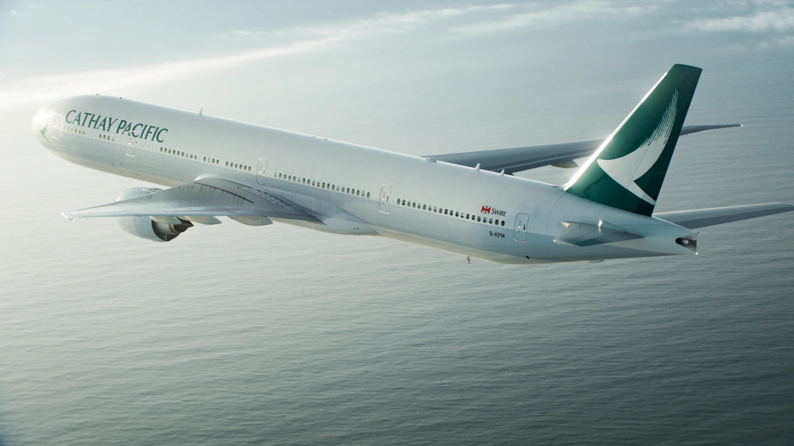
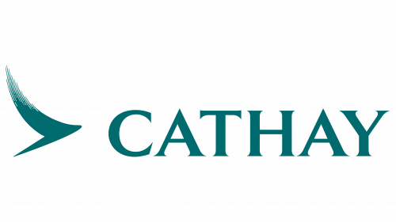
Cathay Pacific Airways Limited (SEHK: 293)
Move Beyond with Cathay Pacific - Invest in the Future!
BUY
35.76% Upside
Target Price: $14.31
Last Close Price: $10.54
Presented by Group 2:
Ching Jia Rong
Charlene Ng Zuqi
Leong Li An
Zhen Penglong

Slide 2
Agenda
1
Overview of the Company
Macroeconomic and Industry Analysis
Investment Thesis
Environmental, Social and Governance
Fundamental Analysis
Stock Valuation
Recommendations
2
3
4
5
6
7

Slide 3
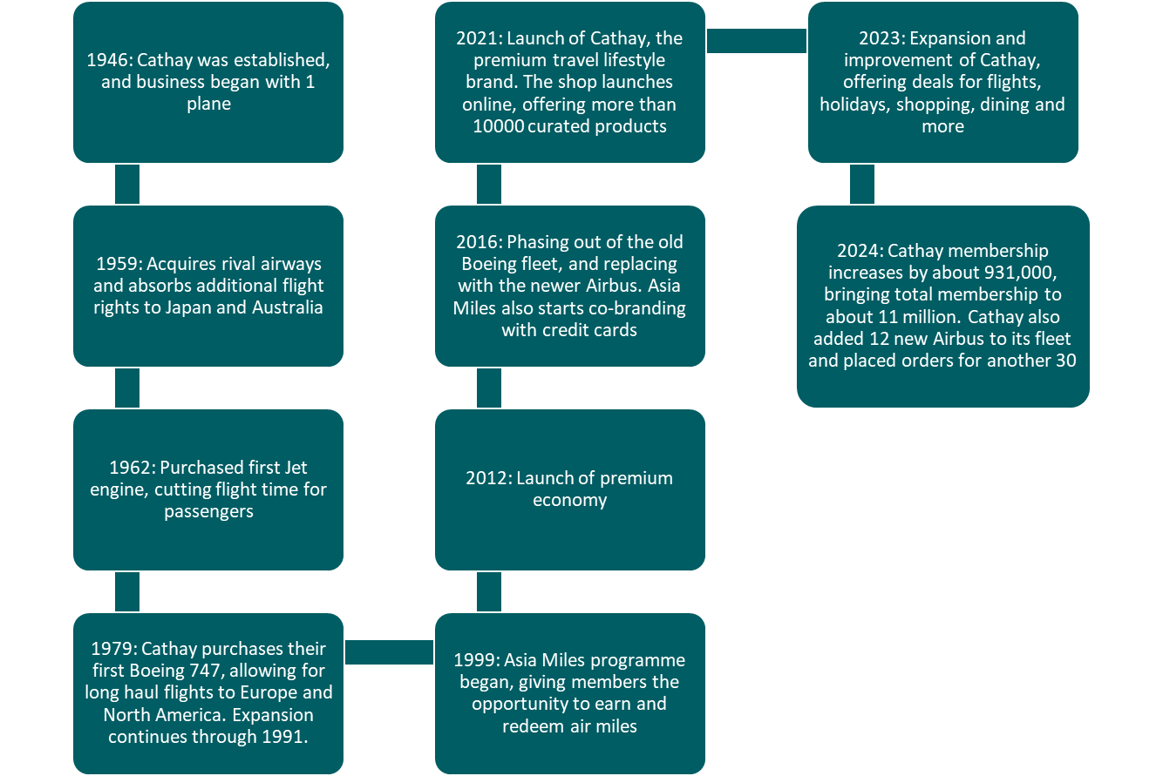
Brief History
Notes:
Started at the end of WW2 by an Australian (Sydney de Kantzow) and an American (Roy Farrell). 1 plane to transport goods between Australia and China.
Name comes from a dream to 1 day cross the Pacific ocean.
Cathay pacific grew and expanded over the years and has a total fleet of about 177 aircraft, a mix of Boeings and Airbus.

Slide 4
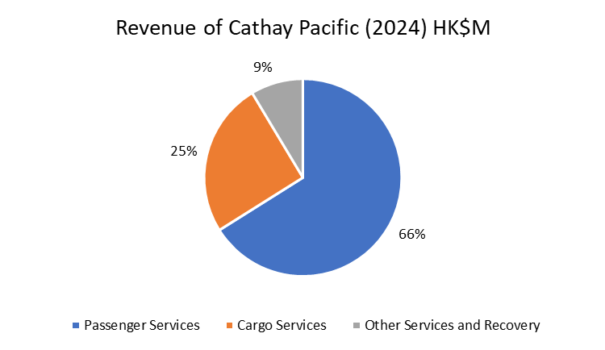
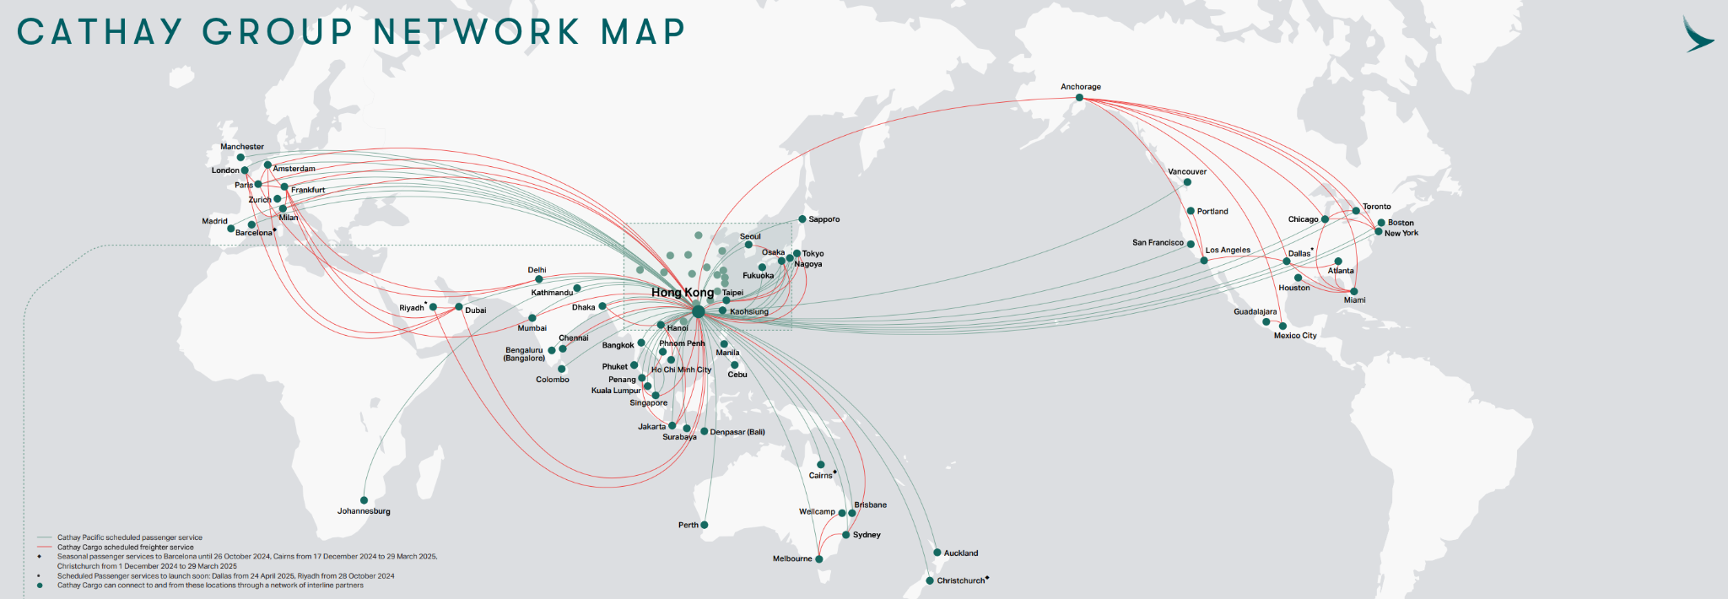
Company Overview
Over the years, Cathay Pacific grew its fleet and now flies to over 80 destinations worldwide
Main business comes from passenger flights, cargo services and lifestyle services through its Asia Miles programme
Flights are primarily in and out of Hong Kong, where its headquarters is located

Slide 5
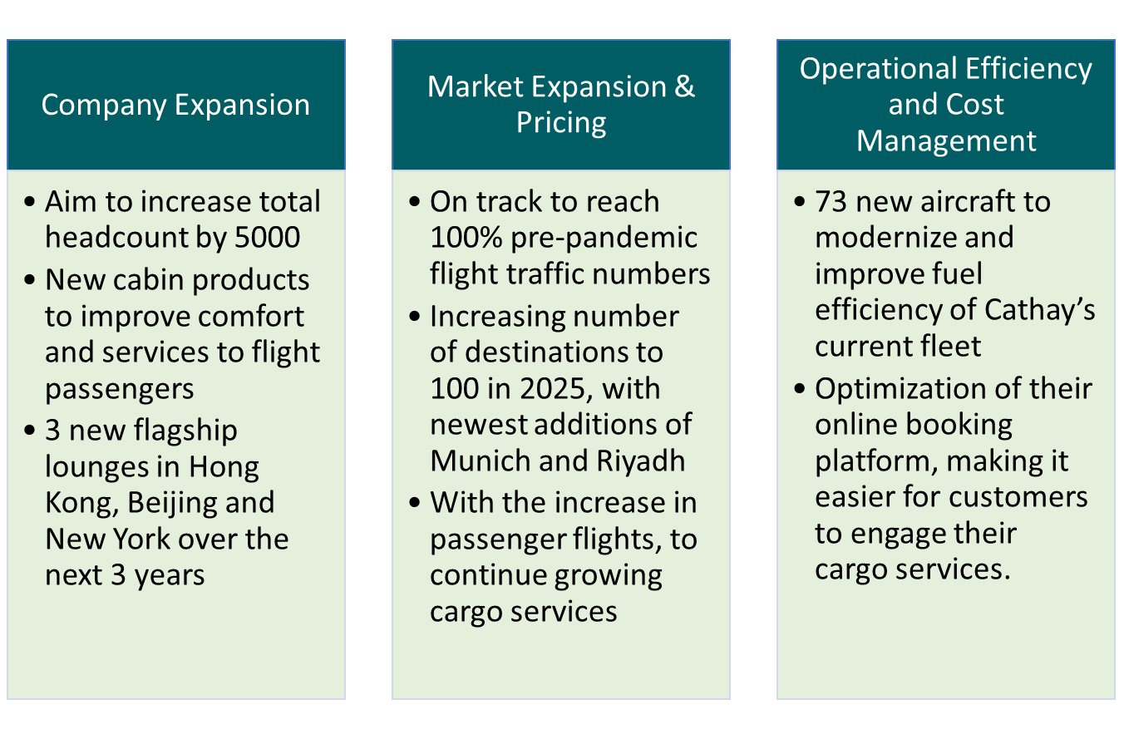
Moving Forward
Notes:
Eg, complimentary wifi for first class and business class next time

Slide 6
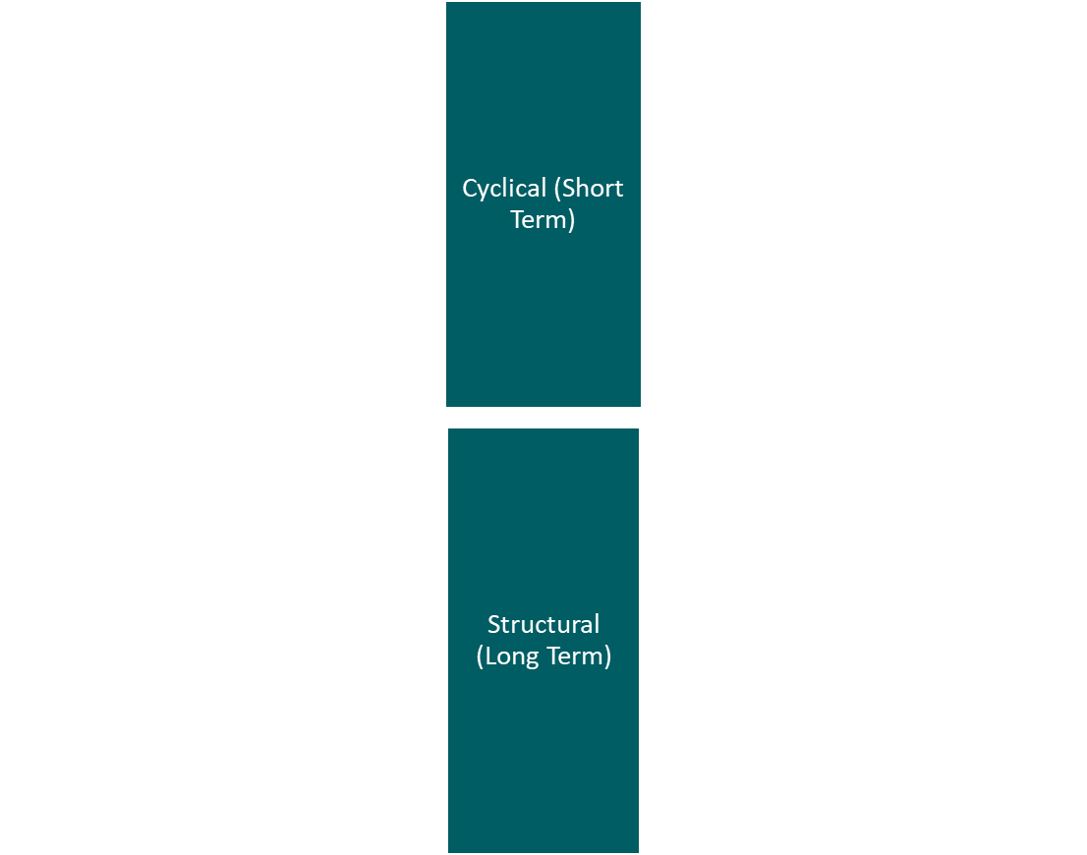
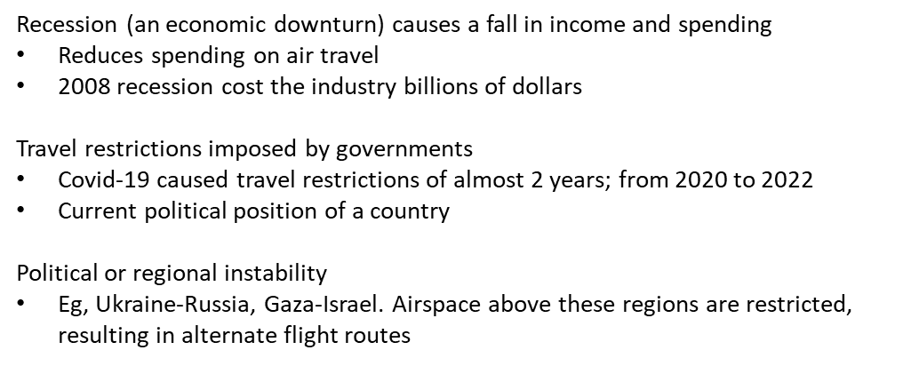
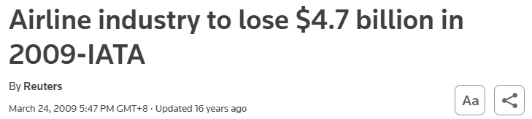

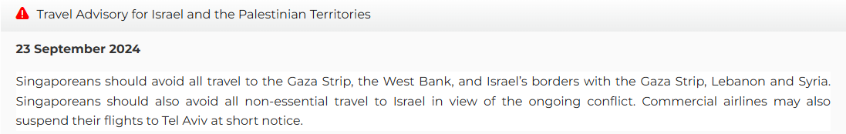
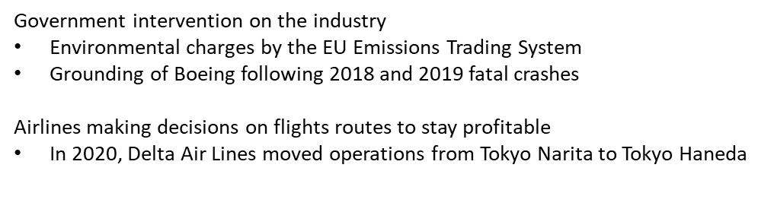
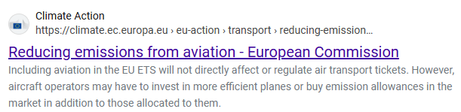
Exogenous Factors Impacting the Airline Industry
Notes:
https://www.mfa.gov.sg/countries-regions/i/israel/travel-page
MFA will regularly update their travel advisory based on world events. Alternate flight routes may be longer and increases operating costs
https://www.reuters.com/article/technology/airline-industry-to-lose-47-billion-in-2009-iata-idUSLO1706/
https://natlawreview.com/article/new-trump-20-travel-ban-expected-target-40-countries-what-you-need-know
Latest travel restrictions by US. Same thing happened when Trump was first president.
https://www.charter.works/2024/01/26/how-much-does-eu-ets-actually-cost-do-you-really-know/
Since the beginning of 2024, as soon as you reach Europe, it is 40% compensation of the amount of CO2 emitted. In 2025, 70% will be charged, then 100%.
Boeing
https://time.com/5889376/boeing-737-max-house-report/
Grounding of Boeing 737 Max. 2018 crash by Lion Air flight from Indonesia and 2019 crash by Ethiopian airlines. Resulting in a total of 346 casualties
https://www.flightglobal.com/strategy/delta-to-end-all-tokyo-narita-flights-with-shift-to-haneda/133864.article
Haneda is closer to Tokyo city center than Narita, therefore they moved operations in a bid to attract more customers

Slide 7
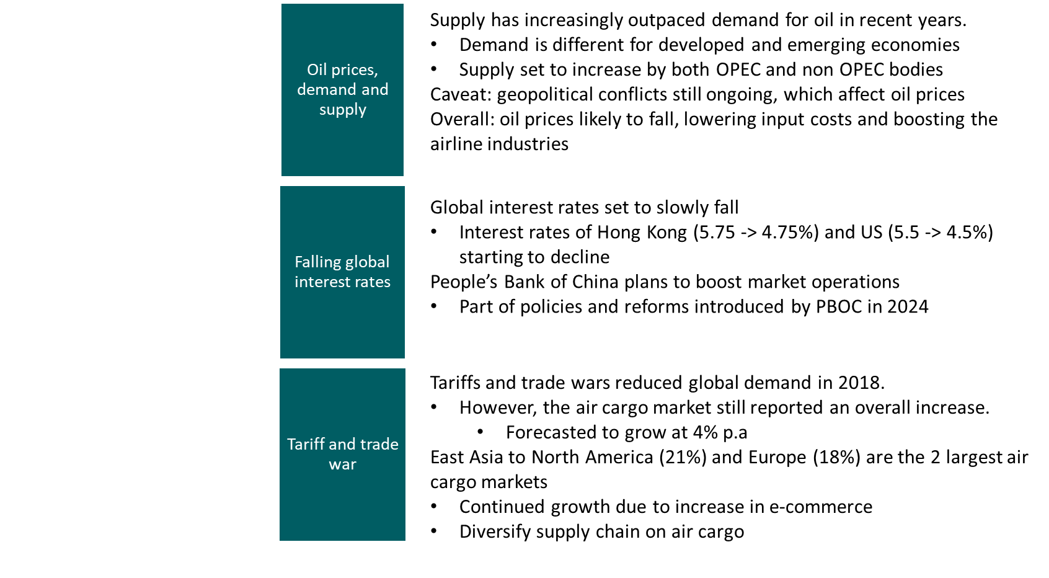
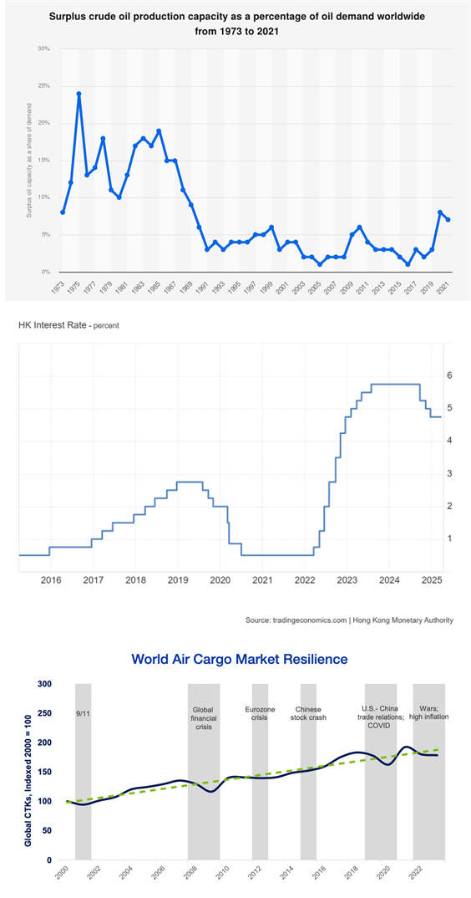
Macroeconomic and Industry Analysis
Notes:
Oil
Demand emerging economies -> driven by emerging economies in Asia – especially higher oil use for transport in India – and by greater use of jet fuel and feedstocks from the booming petrochemicals industry, notably in China
Developed -> demand may fall, as they invest in alternative forms of energy, more fuel efficient technology being developed
Supply -> Plans by OPEC+ to start unwinding voluntary production cuts in April
Geopolitical -> sanctions on russia due to ukraine conflict, while russia is a large producer of oil
Projected growth of global real GDP, which is expected to increase 2.6% annually over the next 20 years. South Asia, China, Southeast Asia, and Africa will lead this growth as their economies continue to develop and mature. Global trade and industrial production, also drivers of air cargo, are projected to grow 2.9% and 2.2% annually over the same period. Global air cargo traffic forecasted to grow 4% p.a
Future air cargo growth is supply chain diversification. The rise of geopolitical risk and the COVID-19 pandemic exposed the vulnerabilities of single-source supply chains, including labor, shipping, and manufacturing constraints. In response, manufacturers have begun diversifying their operations and supply chains to other parts of Asia. Southeast Asian countries, for example, have significantly increased their industrial capabilities and global air exports since 2017 as a result of these shifts.
Multi-node supply chains will depend on air cargo for reliable and timely connectivity across different stages of the manufacturing process. Growth of e-commerce and express networks will provide a further boost to air cargo demand. The entry of new e-commerce market players significantly accelerated air cargo growth in the latter half of 2023 and into 2024 to serve the digital economy
Conclusion: Airline industry poised to expand and grow over the next few years

Slide 8
Industry Analysis - Porter’s Five Analysis
Threat of new entrants
Threat of substitutes
Bargaining power of customers
Bargaining power of suppliers
Competitive rivalry
Low
High capital requirements
Highly regulated industry
Moderate
Alternate modes of transport available for short distance
If distance and time are factors, flights still preferred
Moderate
Many airline companies available to customers
Prices and services offered between companies are competitive
High
Very few aircraft manufacturers and engineers
Aviation fuel is a key supply for airlines, making up 30% of operating costs
High
Many alternative airlines in the region
Information for all companies easily available
Notes:
Threat to new entrants: Low. New players to the aviation industry face high capital requirements to start a company. These include infrastructures, warehouses, aircraft fleet, large pool of employees etc.
Threat of substitutes: Moderate. While there are alternative modes of transport available for short distance transportation, flights are still preferred over trains and buses once distance becomes a factor.
Bargaining of customers: High. There are many alternative airline competitors that operate in the region, offering international flights and cargo transport. Buyers have multiple choices for airline travel, resulting in companies needing to be innovative in their marketing and services offered.
Bargaining of suppliers: High. There are very few niche aircraft manufacturers and suppliers of technological know-how. Suppliers hold considerable influence over the supplies for airline companies. Furthermore, aviation fuel makes up 30% of operating costs (International Air Transport Association, 2024, p. 3), again providing fuel suppliers substantial influence over the price of inputs
Competitive rivalry: High. There are many competitors available in the airline industry, be it from the same Asian region or overseas. This forces each airline company to be creative with what they offer as services.

Slide 9
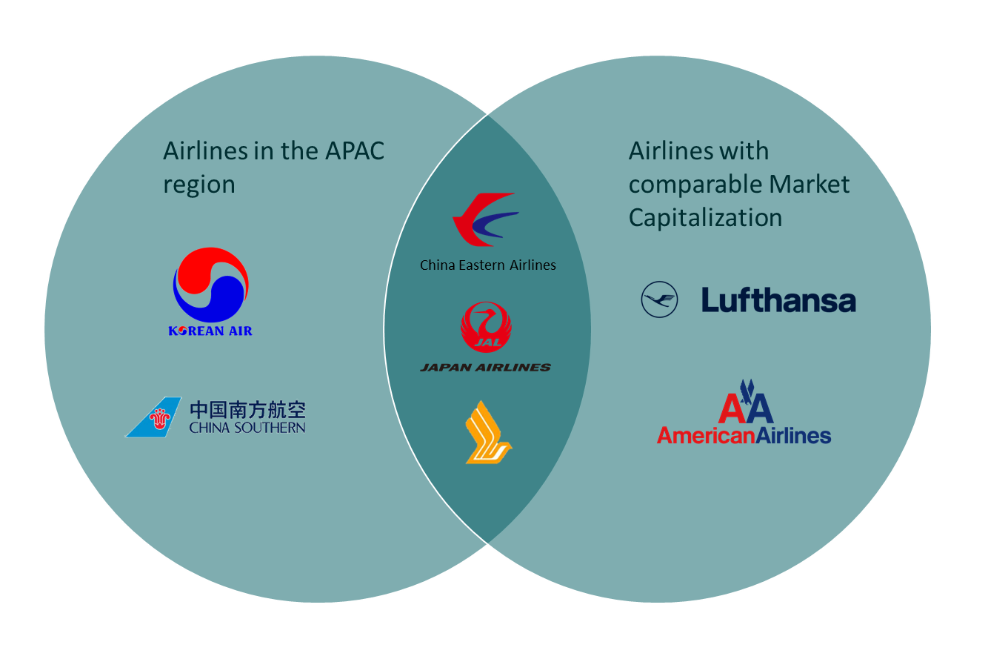
Competitors

Slide 10



Thesis 1: Cathay is poised to capture future revenues with diversified portfolio & good positioning
28+ Codeshare Agreements
(Slightly above industry)
One World Alliance Member
Joint Operating Services (JOS) / Strategic Agreement
2 new upcoming partnership:
Riyadh Air
Japan Airlines
New Upcoming member by end 2025:
Starlux Airline
New total of 900 destinations combined
in 170 territories
Agreement with China & New Zealand:
Route planning, route networks & revenue sharing -> Up to 18 weekly return services between HK and New Zealand
Cathay Membership
Grew to 11 million members
From 10 million
members
In the last 1 year
Partnership with Marriott and Kai Tak Sports Park will help Cathay reach over 8800 hotels with over 30 leading brands & gives access to revenues from global mega events hosted in HK respectively
Notes:
Slew of mileage programs + New Locations + Joint Ventures

Slide 11

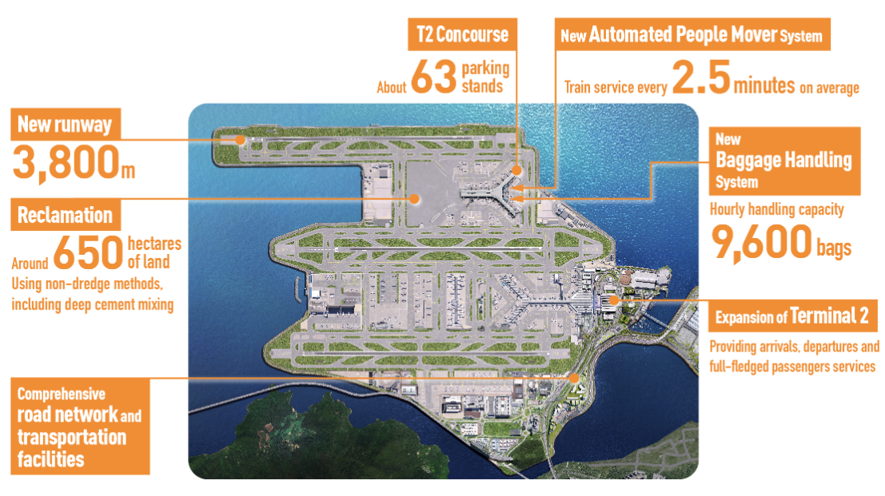



Thesis 1: Cathay is poised to capture future revenues with diversified portfolio & good positioning
100% capacity from Jan 2025 onwards
100 destinations within 2025
8 more new HK and Mainland routes
with Individual Visit Scheme expansion and more planned expansions ahead
Air traffic demand of 120 million passengers by 2035
Resumption of high seasonal demand flights to Barcelona & Cairns
World’s Top 3 Busiest International Flight Routes in 2024
(Source: OAG)
Hong Kong - Taipei
Recorded 6.8 million seats in 2024 and held the number one spot back in 2019
Ranked the third busiest route in 2023
→ Grew 48% in 2024 but remained 15% lower than in 2019
Cario - Jeddah
Seoul (Incheon) - Tokyo (Narita)
Notes:
Taiyuan, Hohhot, Harbin, Lhasa, Lanzhou, Xining, Yinchuan, Urumqi
Three - Runway system development -> continue riding the trend
Established mileage business (Asia Miles)
Product sales business -> retail, hotels, experiences
Cathay membership recruited 931k to 11 million
Earning status point via lifestyle products -> via member festival for member only offers
HK Express major redemption for miles plus cash & miles only options
Miles + cash offering to use a combi of it for seat selection and extra baggage payment
Mileage partnerships with Watsons / Uber taxi / 350 restaurant outlets (Overseas include: Shinsegae DFS korea / mitsui outlet park japan) / (China: Swire Group adopting asia miles / partner with DiningCity to earn miles from booking > 700 restaurants)
Partner with expedia group for cathay holiday booking site

Slide 12
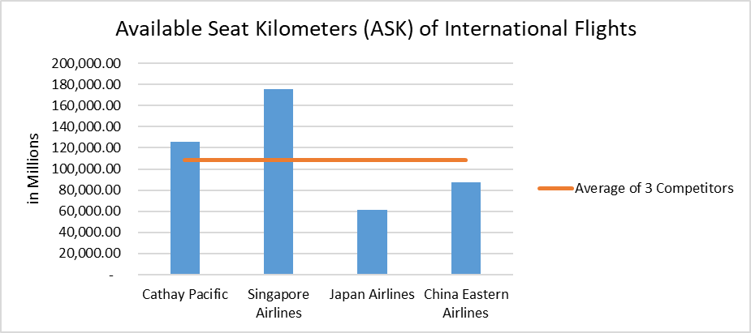
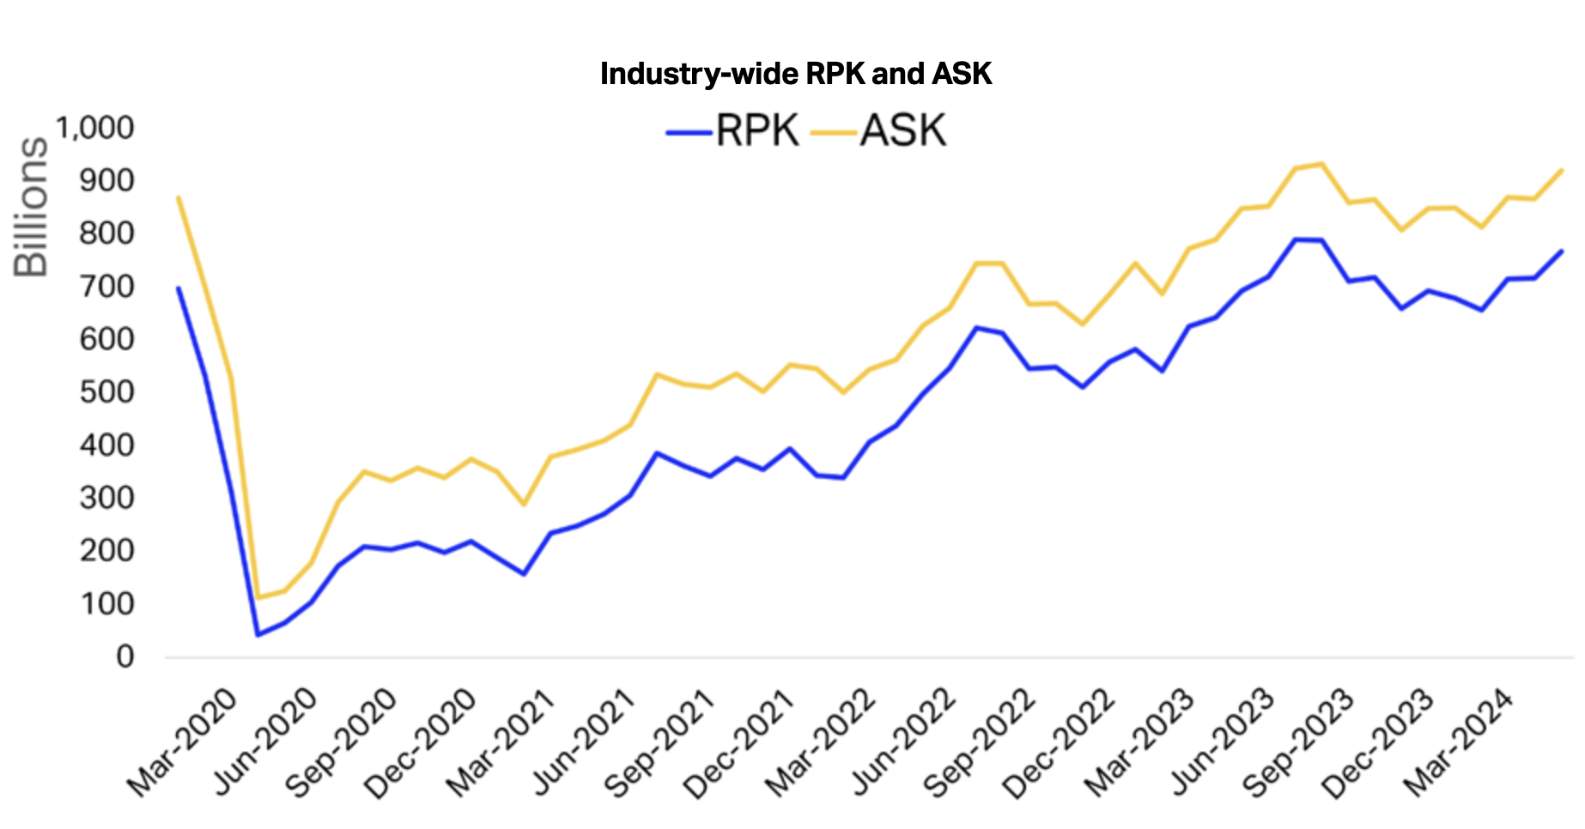
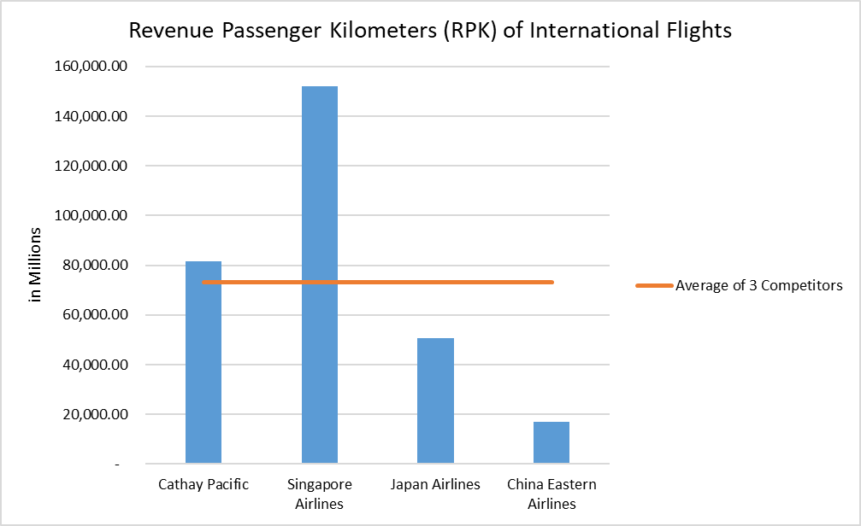
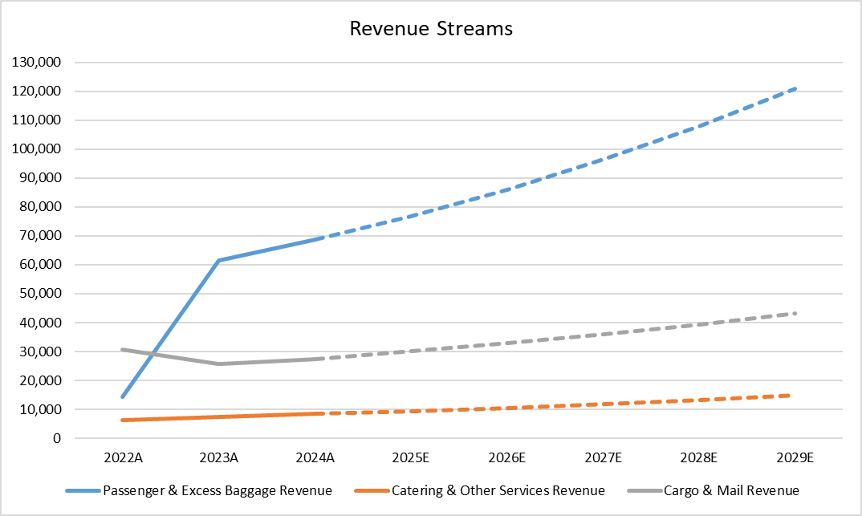
Thesis 1: Cathay is poised to capture future revenues with diversified portfolio & good positioning
Notes:
Can talk about how the RPK & ASK is like the market share of sorts
Which cathay is doing quite well in although not more than SIA but above peers of similar size average
And the industry in general of RPK and ASK is increasing as shown in the table
-> Go and add in

Slide 13
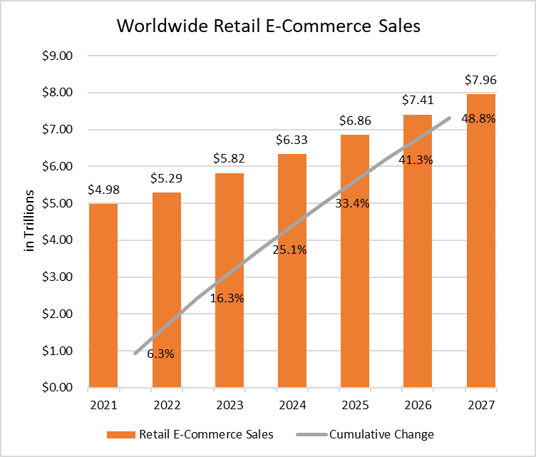






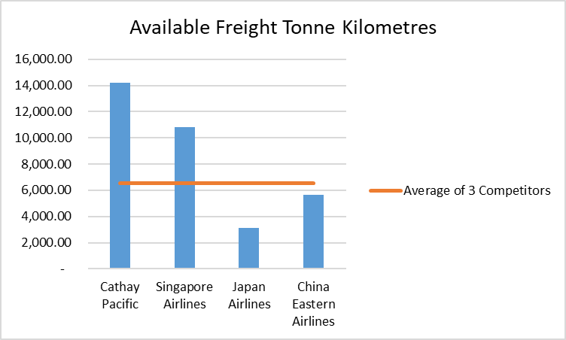


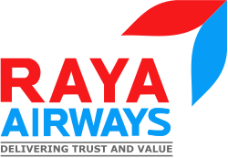





Thesis 2: Cathay can effectively navigate apparent macroeconomic challenges while capitalizing on favourable tailwinds -Tariff?
Continued partnerships & adoption of new tech improving efficiency
Availability to service niche cargo markets
Partnership for urgent, piece level shipment tracking (10/2024)
Additional drivers for continued cargo earnings
- Incorporate AI into thermal imaging programme 2025
- AI Lithium screening - Prevent mis-declarations for cargos which result in delays
Business Insider (12/2024)
Best in its cargo solutioning offerings

Slide 14

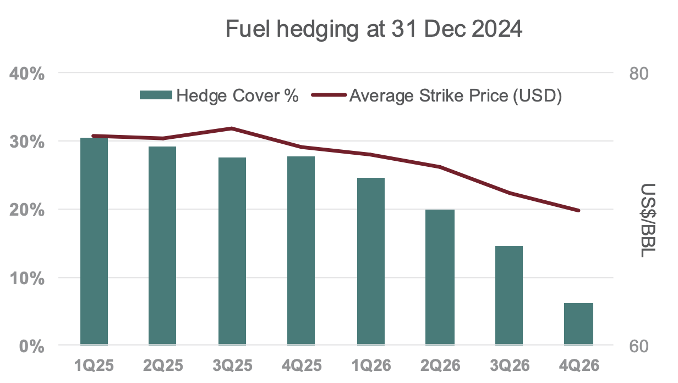
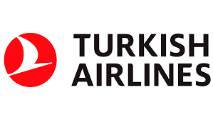




Thesis 2: Cathay can effectively navigate apparent macroeconomic challenges while capitalizing on favourable tailwinds - Others
Eastman Turbo Oil (ETO 2197) - Type 1
HKD 806/bbl (Present) | HKD 570/bbl (By 2030) | -29%
90% type 1
EIA Energy Outlook 2023
Sustainable Aviation Fuel (SAF) - Type 2
HKD 2015/bbl (~ 2.5x price of oil) | HKD 1663/bbl (By 2030) | -18%
10% type 2
Barrel of oil utilized Dec 2024 = 35.1 million
Cost of oil utilized Dec 2024 = HKD 28,295 million
Oil utilization weight for type 1 & 2 by 2030
Non-fuel hedging company successes
Revenue: ~ $8bn
Operating Margins: ~8%
Revenue: ~ $25bn
Operating Margins: ~12%
Fuel Hedging Loss
2020: HKD 9.87bn
Revenue: ~ $581m
Operating Margins: 4.3%
Revenue: ~ $359m
Operating Margins: ~ -5%

Slide 15

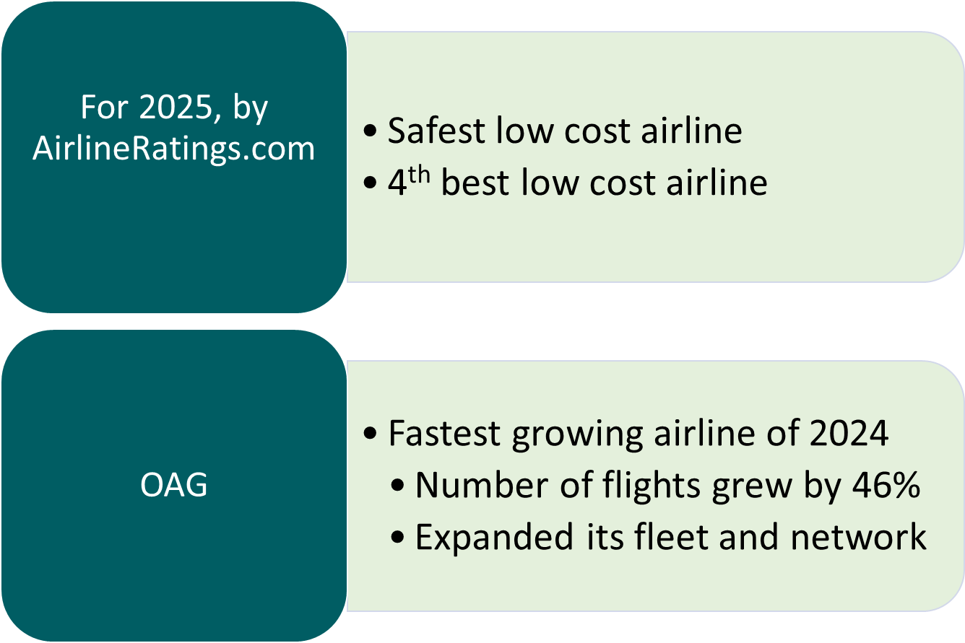


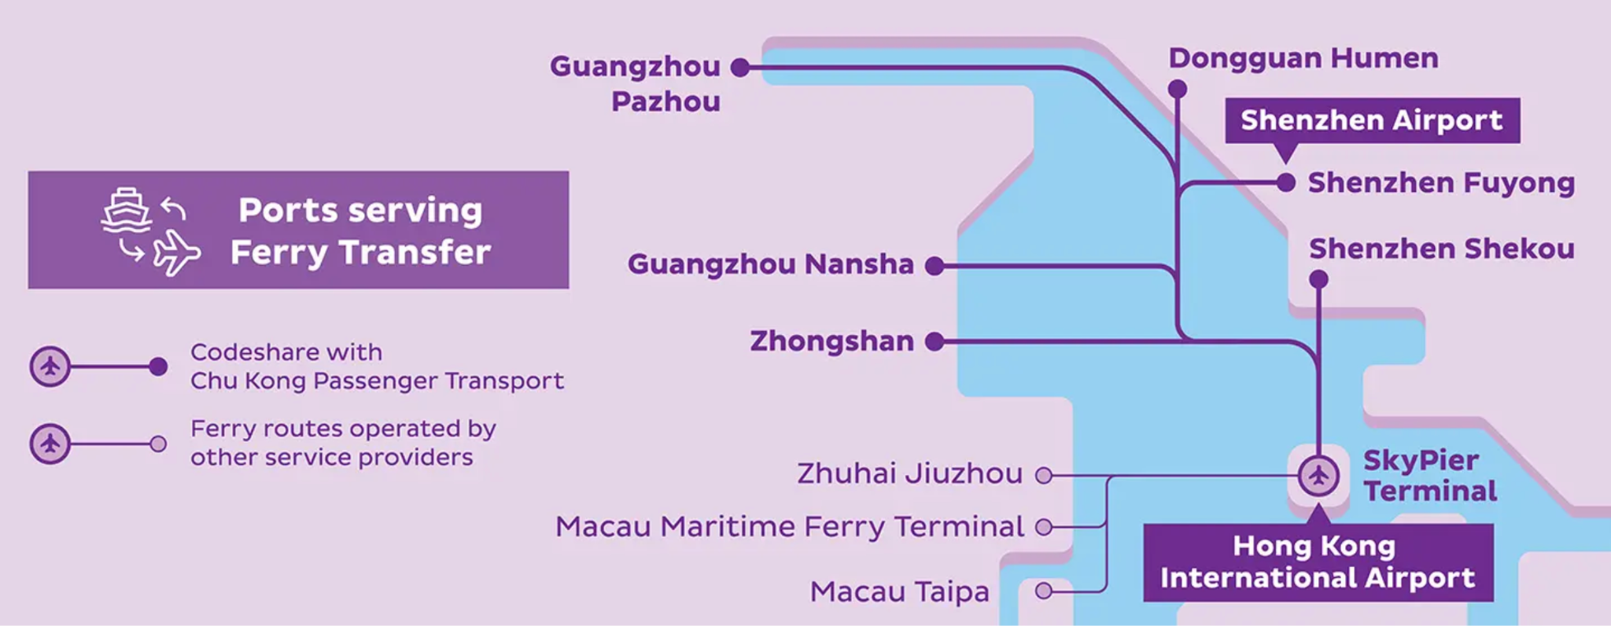
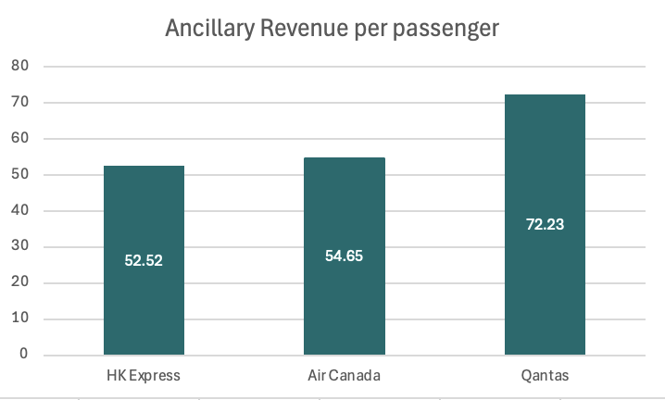
Thesis 3: Past revenue accretive CAPEX to continue paying off and future margin accretive CAPEX to set in - Past CAPEX
Continual progress on fundamental budget airline revenue drivers…
Ancillary Revenue Expansion
Productivity
Timeliness & Offerings Expansion
Acquired by Cathay (2019)
In recent news…
New differentiation on checked baggage tiers:
Ultra Lite, Lite, Essential, Max (06/2024)
Klook & HK Express upcoming partnership for more experiences booking & giveaways (named ‘LIVE MORE’ campaign, 10/2024)
Collaboration with Google BigQuery & Vertex AI for food menu experiences data, customer survey analysis
(05/2024)
Phasing out routes like Don Mueang, Kumamoto with lower yield and replacing it with flights to Cheongju, Daegu, Sendai, Komatsu in Mid 2025
Air + Ferry Network (04/2024)
Year | Load Factor | Passenger Yield | RPK
2024 (Latest Year) | ~83% | 52.2 cents | 11481 million
2020 (Covid Year) | ~70% | 29 cents | 1480 million
2019 (Pre-Covid) | ~88% | 37 cents | 5200 million
Spare capacity
Notes:
World's Best Airlines For 2025
For the image: low cost carriers must have productivity (business efficiencies) to offer low prices; maximum seat capacity, as few employees as possible.
For LCC to be successful, their business model must either add on offering additional services (frequent flyer, seat reservation, larger seat etc.) or on-time performance (aircraft arrival at the gate)
HK express to ride on their growth in flights and expansion of fleet in 2024 to carry it forward into 2025. (Eg, Cathay and HK express are poised to operate to more than 100 destinations in 2025). Also, more aircraft coming in the future
Graph from https://www.forbes.com/sites/greatspeculations/2023/10/05/top-10-airlines-cashing-in-on-extras-like-checked-luggage-and-preferred-seating/
https://www.itnews.asia/news/hong-kong-express-enhances-customer-experience-with-ai-607837
https://www.ttgasia.com/2024/01/12/hk-express-ranks-first-in-asia-for-on-time-arrivals/
What to say for the table:
Since its acquisition in 2019, the following years were immediately met with covid and it hasn’t been able to do much to earn revenue
-> Looking at the available spare capacity that it has and is continue to make progress moving forward etc etc
https://www.hkexpress.com/en/About-Us/Media-Centre/HK-Express-Further-Expands-Its-Air-Ferry-Pass-Network-To-Cover-All-Six-Major-Ports-in-GBA GBA coverage -> Talk about how this is essentially covered all the major ports around Hong Kong

Slide 16
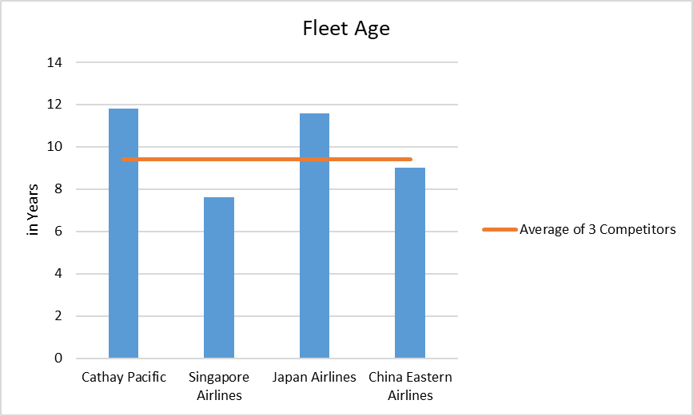
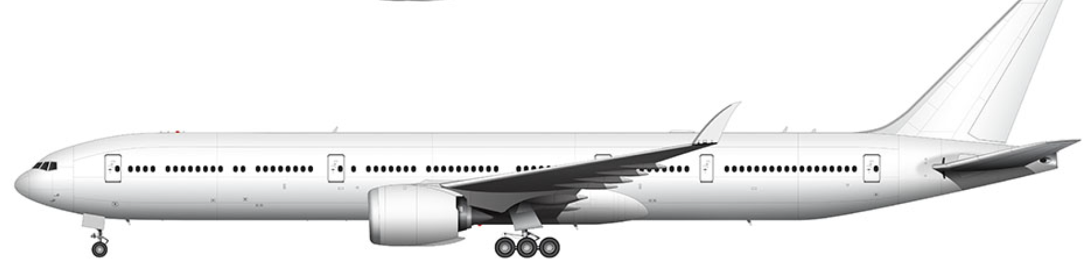
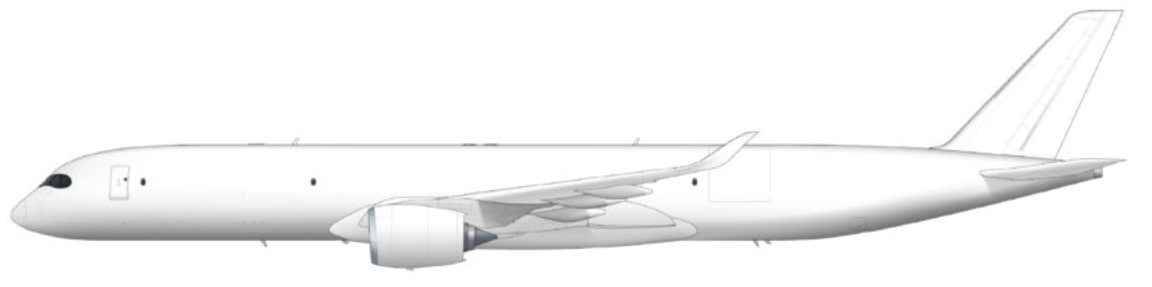
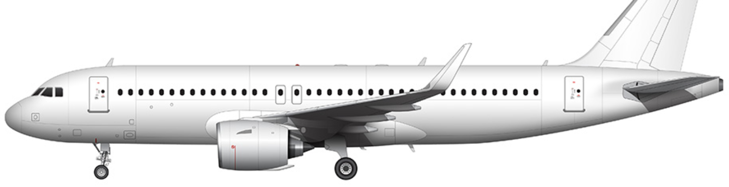
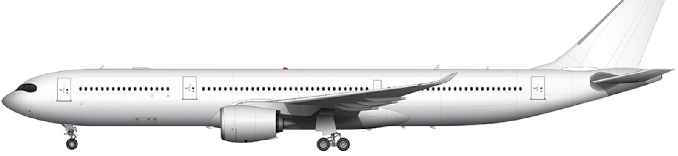
Thesis 3: Past revenue accretive CAPEX to continue paying off and future margin accretive CAPEX to set in - Upcoming CAPEX
New and upcoming renewals and planned depreciation will improve the fleet age for Cathay and achieve much greater efficiency
Boeing 777-9 - 12 % less fuel + 400 capacity
Airbus A350F - 40% less fuel + 111 tonnes payload
A320 Neo - 20% less fuel + 244 capacity
New passenger fleet acquisitions capacity can on average carry 40 more passenger per flight
Average potential fuel OPEX savings of ~ HKD90k per flight
A330-900 - 25% less fuel + 465 capacity
New cargo fleet acquisitions capacity can on average carry 12 tonne more goods
Right to replace ~1/2 of its fleets (Current size: 179)
Notes:
Upcoming CAPEX will reduce the age as shown in this graph
Boeing 777-9 vs current 777-300. More fuel efficient by 10-15%, carries more passengers also (425 vs 365) ie. carries more passengers for less. The Boeing 777X Vs The 777-300ER - What Is The Difference?

Slide 17

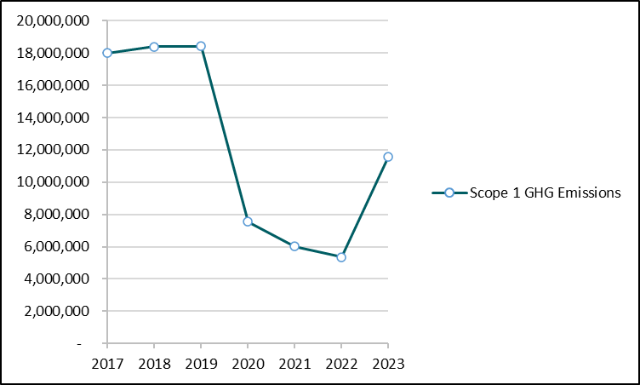
Environment, Social and Governance
Hong Kong’s First Sustainable Aviation Fuel (SAF) Initiative
Improvement of carbon emissions (intensity) since the 1990s by 30% by replacing older aircrafts with newer, more efficient next-generation aircrafts
38 Million US Gallons
Signed an agreement with Aemetis in 2022 to purchase sustainable fuel over the next 7 years
Scope 1: CO2 occurred from direct emitting sources controlled by or owned by Cathay
10% of TFC
Among the first airlines in the world to commit a target by 2030
15 Partners
Partnership with global brands to accelerate the initiative
Notes:
Sources: → https://www.aemetis.com/aemetis-signs-agreement-with-cathay-pacific-to-supply-38-million-gallons-of-sustainable-aviation-fuel/
→https://news.cathaypacific.com/cathay-welcomes-the-hong-kong-sustainable-aviation-fuel-coalition-s-policy-whitepaper-to-accelerate-the-city-s-saf-ecosystem-development-pk49u3#:~:text=Cathay%20Pacific%20was%20among%20the,Kong%20and%20other%20airports%20worldwide
→ https://news.cathaypacific.com/cathay-celebrates-record-growth-in-its-corporate-programme-to-advance-sustainable-aviation-fuel-use-g8noux
Notes:
Need to add in notes for carbon intensity target
In 2023, they introduced 4 brand new A321-Neo with 20% reduction of fuel consumption per seat for HK Express (their low-cost carrier)
Recycle or repurpose around 90% of all retired airplanes
Aemetis is a renewable fuels company focused on negative carbon intensity products
Among the 1st airlines in the world to commit (2021) to a 2030 usage target of 10% SAF in total fuel consumption on its operating flights.
To accelerate the SAF transition, Cathay launched its Corporate SAF Programme in 2022, enabling members to reduce their indirect emissions associated with air transportation. HSBC Hong Kong was a launch member with a committed use of over 6,050 metric tonnes of SAF in 2024.
Scope 1 are direct GHG emissions which is CO2 which occur from direct emitting sources controlled or owned by Cathay (i.e., combustion of aviation fuel)
While total emissions have increased by 116% from 2022, they are below pre-pandemic levels.

Slide 18
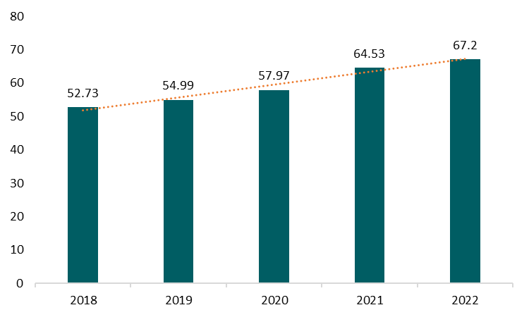






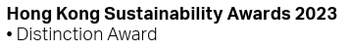
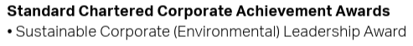

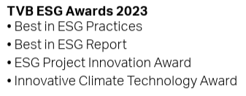
Environment, Social and Governance
Sustainable/Green Initiatives
Governance
Bloomberg’s ESG Disclosure Score
YoY Increase:
73% of total seafood purchased from certified sustainable sources in 2023
98% completion rate of anti-bribery training
Exceeded 2022 target set in 2019 to reduce SUP by 50% (387m pieces)
New 2025 target: Reduce SUP to 1.5 pieces per passenger
Senior 2025 Target: 35% (Current: 27%)
Board 2027 Target: 30%
(Current: 12%)
Social
Accolades
2,700 hours of volunteer work in 2023
Donation of 1,161,000 pieces of everyday items
One of the first airlines to introduce the Fatigue Risk Management System (FRMS) in 2011 with further enhancement and expansion in 2023
Notes:
Sources: ESG Disclosure Score: Bloomberg Terminal
Notes:
Sustainable Seafood: Up from 40% in 2021, and 70% in 2022
Passenger-facing SUP in 2023 is 3.1, down from 4.8 in 2022 and 7.5 in 2021
Recognised as a leader in FRMS
Mitigations are tailored to specific risks identified and the effectiveness is tracked using Safety Performance Indicators
FRMS is subject to both internal and external audits

Slide 19
Financial Performance Overview
 | 2019 | 2020 | 2021 | 2022 | 2023 | 2024
Revenue (in HK$) | 106,973 mil | 46,934 mil | 45,587 mil | 51,036 mil | 94,485 mil | 104,371 mil
Net Income (in HK$) | 1,691 mil | (21,648) mil | (5,527) mil | (6,623) mil | 9,789 mil | 9,888 mil
Liquidity Funds (in HK$) | 14,864 mil | 19,341 mil | 19,284 mil | 18,277 mil | 15,530 mil | 10,534 mil
Total Debt/Equity | 155% | 127% | 124% | 121% | 114% | 130%
EPS | 0.43 | (4.24) | (0.95) | (1.12) | 1.41 | 1.49
Dividends (in HK$) | 708 mil | - | - | - | 2,768 mil | 4,443 mil
Revenues and Net Income
Revenue increasing from HK$46.9 billion in 2020 to HK$104.4 billion in 2024, the revenue has nearly returned to pre-pandemic levels. After suffering significant losses from 2020 to 2022, the company returned to profitability in 2023 with a net profit of HK$9.8 billion, which increased to HK$9.9 billion in 2024.
Financial Structure
The company’s financial structure has remained resilient, with liquidity funds consistently around HK$15 to billion HK$19 billion from 2019 to 2023. However, liquidity funds decrease and net debt increased in 2024 due to capital investments (i.e. HK$9,277 million in additional PPE) and payments for preference shares redemptions (HK$9,750 million), pushing the debt-to-equity ratio slightly higher to 130%.
EPS and Dividend Payment
Cathay Pacific resumed dividend payments in 2023 with amount of HK$2.8 million, followed by a significant 60% increase to HK$4.4 million in 2024,. Earnings per share also improved accordingly, these indicates Cathay’s confidence in its cash flow and financial strength which reflects stronger operational performance.
Overall, Cathay Pacific is in a strong post-pandemic position, balancing its expansion plans with shareholder returns.
Notes:
Sources: ESG Disclosure Score: Bloomberg Terminal
Notes:

Slide 20
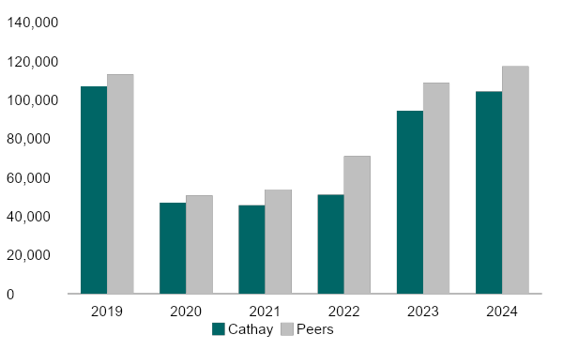
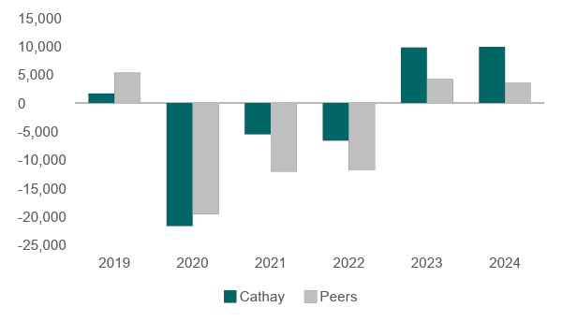
Financial Performance Compared with Industry
Revenue Growth (HK$M)
Net Income (HK$M)
Cathay's revenue declined significantly during the pandemic, with a slower recovery compared to its peers. By 2022, revenue began improving but remained below industry averages. However, strong growth in 2023 and 2024 with revenue reaching nearly matching the peer average.
Cathay suffered heavy losses in 2020, exceeding those of its peers. However, from 2021 to 2022, it performed better than its peers despite continued losses during the pandemic. The company returned to profitability in 2023, outperforming its peers, and maintained strong results in 2024. This reflects a faster recovery from the pandemic compared to the industry.
Notes:
Sources: ESG Disclosure Score: Bloomberg Terminal
Notes:

Slide 21
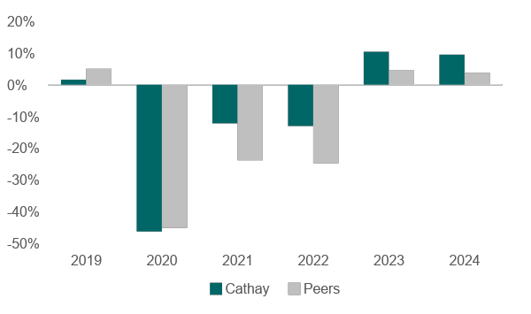
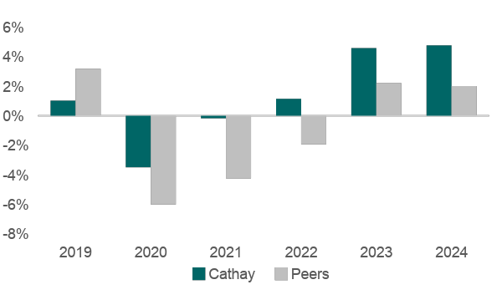
Financial Performance Compared with Industry
Net Income Margin
Return on Assets
Cathay suffered heavy losses in 2020, with its net profit margin falling below that of its peers. However, from 2021 to 2022, its net profit margin remained more stable than the industry average. The company returned to profitability in 2023 with a positive net profit margin, outperforming peers, and sustained strong margins in 2024.
Although Cathay’s Return on Assets (ROA) was lower than the industry before the pandemic, it performed slightly better during 2020 to 2022. By 2022, Cathay's ROA had returned to pre-pandemic levels and continued to rise. Cathay’s ROA improved significantly after the pandemic, outperforming peers in 2023 and 2024. This indicates its stronger recovery and better efficiency in utilize of assets than its competitors.
Notes:
Sources: ESG Disclosure Score: Bloomberg Terminal
Notes:

Slide 22
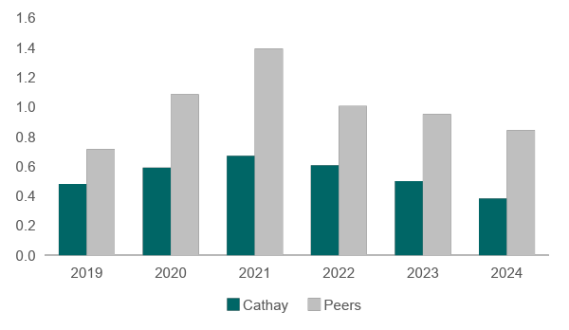
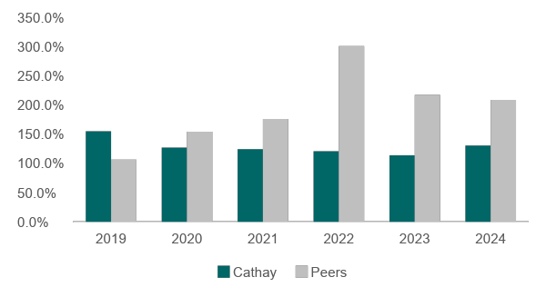
Financial Performance with Industry
Current Ratio
Debt to Equity Ratio
Cathay’s current ratio remained below the industry average over the past five years, showing its weaker liquidity. The drop in 2023 and 2024, due to preference share redemption and expansion spending, which indicates higher working capital pressure. This suggests Cathay may not have enough short-term assets to cover its short-term liabilities. And it relies more on cash flow management to meet its short-term obligations.
Cathay has followed a more conservative debt strategy than its peers, keeping its debt-to-equity ratio below 1.5. While industry leverage peaked above 3 in 2022 during pandemic and remained above 2 in 2023 and 2024, Cathay stayed below 1.5, indicating a more stable financial structure. The slight increase in 2024 was due to expansion investments. Its lower reliance on debt suggests stronger financial stability and lower risk.
Notes:
Sources: ESG Disclosure Score: Bloomberg Terminal
Notes:

Slide 23
Dividends Payment Analysis
 | 2019 | 2020 | 2021 | 2022 | 2023 | 2024
Dividends declared (in HKD) | 708 mil | - | - | - | 2,768 mil | 4,443 mil
Dividend per share | 0.18 | - | - | - | 0.43 | 0.69
EPS | 0.43 | - | - | - | 1.41 | 1.49
Dividends payout ratio | 41.86% | - | - | - | 30.54% | 46.31%
In 2023, the airline returned to profitability and resumed dividend payments at HK$0.43 per share, resulting in a dividend payout ratio of 30.54%. In 2024, as profitability stabilized as 2023, the dividend per share increased to HK$0.69, pushing the payout ratio to 46.31%. The increase in dividend payment from 2023 to 2024 is 60%.
We do not think Cathay’s dividend growth is sustainable for the following reasons:
Volatile historical dividend payment before pandemic: Our analysis of Cathay’s dividend payment over the five years prior to the pandemic shows significant volatility. This inconsistency indicates a lack of a clear upward trend, suggesting that dividend growth was not stable even in more normal operating conditions.
High Capital Expenditure Commitments: Cathay is undertaking an expansion plan involving over HK$100 billion over the next seven years, focused on fleet growth, infrastructure investment, digital upgrades, and service enhancements.
Weak Current Ratio: Cathay’s current ratio in 2024 is only 0.38, well below the industry average. Despite, liquidity fund was around HK$10 billion, it still need to be used for debt repayments and lease obligations.
Rising Leverage and Ongoing Debt Obligations: Cathay’s D/E ratio in 2024 is 130%, indicating significant reliance on borrowing. While earnings have recovered, interest payments and debt servicing remain a burden.
Notes:
Sources: ESG Disclosure Score: Bloomberg Terminal
Notes:

Slide 24
Capital Structure
2024 Capital Structure
No. of outstanding shares | 6,439 mil | EV/EBITDA | 4.5x
Closing Price (in HK$) | 9.57 | Debt/Equity Ratio | 130%
Market Capitalisation (in HK$) | 61,621 mil | Total Debt/Capital | 57%
Enterprise Value (EV) | 109,413 mil | Total Debt/Assets | 40%
WACC
Debt weight | 53% | Market risk premium | 6.83%
Equity weight | 47% | Risk free rate | 3.68%
Tax rate Hong Kong | 16.50% | Beta | 0.55
Cost of Debt | 5.89% | Cost of Equity | 7.47%
WACC | 6.13%
Cathay relies on debt financing more than equity in the Company's operation, with a D/E ratio of 130%. However, equity is the key component in financing total assets, as 40% of the assets are funded by borrowing and the rest 60% is by equity. This balanced approach allows the company to grow and expansion through debt while maintaining financial stability with the use of equity to finance assets.
Cost of Equity:
Beta: Major based on linear regression.
Market Risk Premium: Implied Market Risk Premium. Since linear regression on MRP is negative, can not be used.
Risk free rate: Hong Kong 10-year Government Bond.
Cost of Debt:
Implied Cost of Debt.
Index Spread.
Notes:
Sources: ESG Disclosure Score: Bloomberg Terminal
Notes:

Slide 25
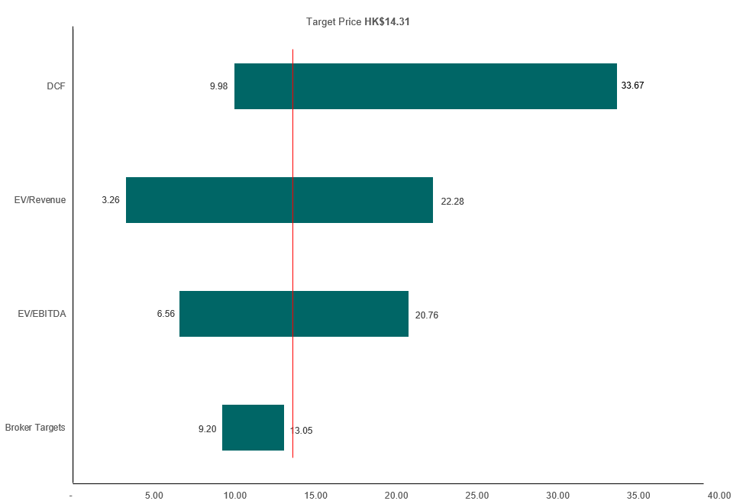
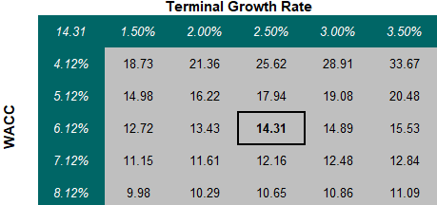
Valuation
Relative Valuation using Multiples
WACC & TV Growth Rate Sensitivity
Discount Cash Flow Model Drivers
WACC: 6.13%
Load, ASK, AFTK, Passenger Yields
IATA, OAG Forecasts
Relative Valuation Drivers
Peers: SIA, Japan Airlines, China Eastern Airlines
Approach: Forward multiples and median

Slide 26

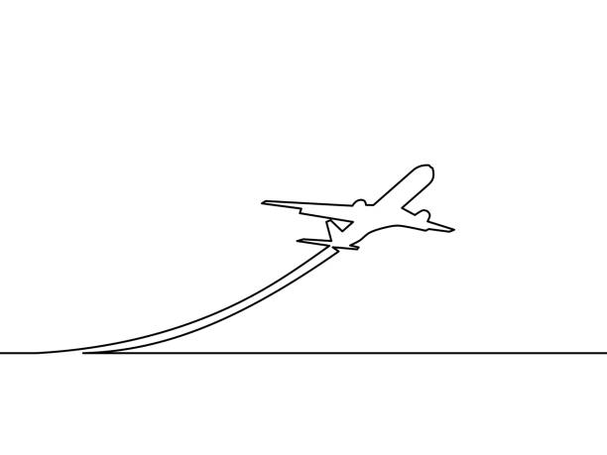


Recommendation
Taking everything into account, we support a buy recommendation of $14.31; 35.76% premium
Future revenues from diversified portfolio and good positioning
Navigate macroeconomic challenges and capitalizing tailwinds
BUY
35.76% Upside
Target Price: $14.31
Last Close Price: $10.54
Past CAPEX paying off, future CAPEX setting in

Slide 27

Appendix

Slide 28
Assumptions
Passenger Revenue | [(new RPK * new Yield * new Load Factor) / (old RPK * old Yield * old Load Factor)] - 1 Value arrived: 12% revenue growth | Load Factor: Industry’s load factor stands at about 70% (IATA) -> Cathay is currently at 83.2% at similar levels as pre-pandemic. RPK & ASK are likely to rise in lock steps. Hence, our team are of the view of a marginal fall in the numbers even as revenue, though expected to rise, are facing macroeconomic uncertainties mentioned while the strategic expansion and new locations meant distance covered is likely to rise. RPK: Management guidance of a YTD increase of about 27% and passenger yield decreased by 12%. We expect RPK to be higher due to the greater number of travel destinations and partnerships opening up and passenger yield to remain similar or with slight improvements due to the very same reason and that revenue would not be able to rise exponentially faster than the distance travelled and paying passenger demand.
Freight / Cargo Revenue | [(expected new AFTK * expected new Cargo Yield * expected new Cargo Load Factor) / (old AFTK * old Cargo Yield * old Cargo Load Factor)] - 1 9.5% Cargo revenue is derived from this formula
Catering & Other Services Revenue | No other information and guidance provided and hence is assumed to be straight lined over the next few years
OPEX - Staff Costs | Fuel costs are well declining due to modern fleet and good hedge of future oil prices will offset the likely increase Staff: Staff costs are likely to increase even as management announced to increase jobs by another 4000 over the coming years IATA projected that labour costs will be about 7.6% which we expect to normalize off to historical cost as productivity gains due to digitalization is an aspect Cathay is embarking on. https://www.iata.org/en/pressroom/2024-releases/2024-12-10-01/#:~:text=The%20largest%20of%20the%20non,4%25%20to%203.3%20million%20people.
OPEX - Oil costs | Fuel: Fuel efficiency with the new fleets + favourable oil economics + Less hedging costs offsetted by more routes + planes -> https://www.iata.org/en/pressroom/2024-releases/2024-12-10-01/#:~:text=The%20largest%20of%20the%20non,4%25%20to%203.3%20million%20people. Its fuel demand growth is expected to be about 7% and supply by approximately 5% -> 1% net (IATA & OPIS) https://www.opisnet.com/blog/2025-likely-to-bring-lower-jet-fuel-prices-higher-demand/

Slide 29
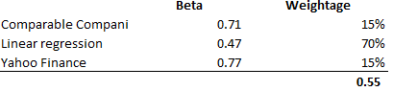
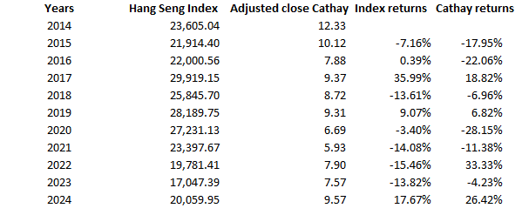
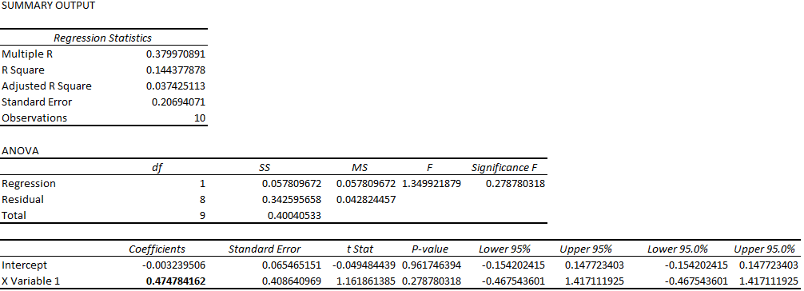
Beta Calculation
Cathay’s beta was calculated using:
Linear regression: The primary input was a beta of 0.47, derived from a 10-year regression of Cathay’s returns against the Hang Seng Index. This beta was viewed as the most accurate reflection of Cathay’s market risk. Given its reliability, while also accounting for the pandemic’s impact on the airline industry, it was assigned with a weight of 70%.
Peers: We also used a peer-based beta, calculated from comparable airlines in the same region with similar market capitalizations. These peer betas were unlevered, and then releveled using Cathay’s own D/E ratio. Although useful for benchmarking, peer betas are less precise due to business model differences and were therefore assigned a moderate weight of 15%.
Beta from Yahoo Finance: Finally, we included the 5-year monthly beta from Yahoo Finance, a commonly used source in both industry and academic research. While reliable, its methodology is not fully transparent and may not capture regional market dynamics. As a result, it was assigned a conservative weight of 15%.

Slide 30


Market Risk Premium
We calculated the MRP for Hong Kong by using 10 year’s Hang Seng Index return and risk free rate from Hong Kong Government 10 year Bond. But we got a negative MRP. Since CAPM valuation assumes that investors require extra return for taking risk. Negative market risk premium can not be used in CAPM valuation because it indicates that investors expect the market to perform worse than risk-free assets, which is not in line with the basic principle of investing. Thus, we took the Implied Market Risk Premium (IMRP) from http://www.market-risk-premia.com/
Considering the volatility of Hong Kong market in the past 10 years, relying on just one type of MRP can lead to inaccurate valuations. To balance this, we use a blended approach by giving 70% weight to the historical MRP, which reflects long-term average expected returns, and 30% to the forward-looking (implied) MRP, which reflects current market expectations. This method helping to account for both stability and current market conditions. It provides a more balanced and realistic estimate for use in valuation models.

Slide 31





Cost of Debt
Cathay’s cost of debt was calculated using:
Interest bearing liabilities: This method uses our future estimates of interest and debt to calculate the cost of debt. Since we assume both will stay stable, it gives a useful view of expected costs. But because it may not fully reflect market changes, we give it a 30% weight.
Index spreads: This market-based approach reflects current borrowing conditions using Cathay’s implied rating (A-) and benchmark spreads. It is forward-looking, based on comparable market conditions, and is thus more relevant for future cost estimates. Therefore, it gets the highest weight of 70%.
Synthetic credit rating: The synthetic credit rating (based on the Altman Z-Score) shows CCC, which implies a much higher cost of debt (15.94%). However, this appears to be overly conservative or inconsistent with actual borrowing behavior. As a result, this method is excluded from the weighted average to avoid overstating the cost of debt.
Convertible Bond (YTM): Cathay issued 2.75% (semi-annually) guaranteed convertible bonds in January 2021 with a total value of HK$6,740 million (issue at par with out discount or premium), maturing in February 2026. The bond has a face value of HK$100 and was trading at HK$122.19 (from Capital IQ) as of December 2024. This results in a negative YTM, which is not meaningful. Additionally, the convertible bonds make up only 9.81% of total debt in Dec 2024, and Cathay has repurchased 68% of them in Jan 25 which means the bond only make up around 3% of the total debt after repurchasing. As such, we excluded this YTM from the cost of debt calculation, as it does not fairly represent the company’s actual borrowing cost.

Slide 32
References
Cathay Pacific Airways. (n.d.). History. Cathay Pacific. https://www.cathaypacific.com/cx/en_HK/about-us/about-our-airline/history.html
International Air Transport Association. (2024). Global outlook for air transport – A world with lower oil prices? IATA. https://www.iata.org
MarketLine. (2024). Global airline industry profile. MarketLine. PDF file.
International Air Transport Association. (2024, December). Air cargo market analysis - December 2024. IATA. https://www.iata.org/en/iata-repository/publications/economic-reports/air-cargo-market-analysis-december-2024/
Boeing. (2024). World air cargo forecast 2024. Boeing. https://www.boeing.com/content/dam/boeing/boeingdotcom/market/assets/downloads/Boeing-WACF-2024.pdf?v=2
Ministry of Foreign Affairs Singapore. (n.d.). Israel travel page. Retrieved March 25, 2025, from https://www.mfa.gov.sg/countries-regions/i/israel/travel-page
Reuters. (2009, June 7). Airline industry to lose $4.7 billion in 2009: IATA. Reuters. https://www.reuters.com/article/technology/airline-industry-to-lose-47-billion-in-2009-iata-idUSLO1706/
The National Law Review. (n.d.). New "Trump 2.0" travel ban expected to target 40 countries: What you need to know. https://natlawreview.com/article/new-trump-20-travel-ban-expected-target-40-countries-what-you-need-know
Charter Works. (2024, January 26). How much does EU ETS actually cost? Do you really know? https://www.charter.works/2024/01/26/how-much-does-eu-ets-actually-cost-do-you-really-know/

Slide 33
References
Gregory, S. (2020, September 16). Boeing 737 Max: House report finds 'repeated and serious failures' by Boeing and the FAA. Time. https://time.com/5889376/boeing-737-max-house-report/
Ostrower, J. (2019, August 1). Delta to end all Tokyo Narita flights with shift to Haneda. FlightGlobal. https://www.flightglobal.com/strategy/delta-to-end-all-tokyo-narita-flights-with-shift-to-haneda/133864.article
U.S. Energy Information Administration. (n.d.). Global surplus crude oil production capacity. U.S. EIA. https://www.eia.gov/international/analysis/special-topics/Global_Surplus_Crude_Oil_Production_Capacity
ING. (2024). Macro outlook: Central bank calls 2025. ING Think.
https://think.ing.com/articles/macro-outlook-central-bank-calls-2025/#a5
HK Express. (n.d.). HK Express airline profile. Routesonline. https://www.routesonline.com/airlines/3737/hk-express/
Majerová, V., & Jirásek, M. (2023). Flying high on low cost: Success in the low-cost airline industry. PLoS ONE, 18(12), e0294638. https://doi.org/10.1371/journal.pone.0294638
AirlineRatings.com. (2025). World’s best airlines for 2025. https://www.airlineratings.com/articles/worlds-best-airlines-for-2025
Travel + Leisure Asia. (2025). World’s safest airlines rankings 2025 revealed. https://www.travelandleisureasia.com/global/news/worlds-safest-airlines-rankings-2025-revealed/
OAG. (2024). Air travel statistics 2024. https://www.oag.com/blog/air-travel-statistics-2024

